Slide 1
Etherchannel

Slide 2
Resources
2960 12.2(55)SE
http://www.cisco.com/c/en/us/td/docs/switches/lan/catalyst2960/software/release/12-2_55_se/configuration/guide/scg_2960/swethchl.html

Slide 3
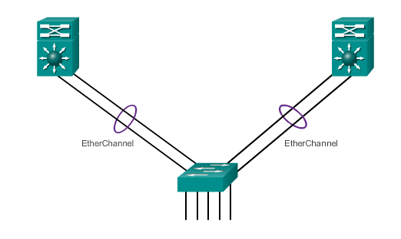
Link Aggregation Introduction to Link Aggregation
Link aggregation allows the creation of logical links made up of several physical links.
EtherChannel is a form of link aggregation used in switched networks.
Notes:
3.1.1.1 Introduction to Link Aggregation

Slide 4
Link Aggregation Advantages of EtherChannel
Most configurations are done on the EtherChannel interface ensuring consistency throughout links.
Relies on existing switch ports – no need for upgrades.
Load-balances between links on the same EtherChannnel.
Creates an aggregation viewed as one logical link by STP.
Provides redundancy because the overall link is viewed as one logical connection. If one physical link within channel goes down, this does not cause a change in the topology and does not require STP recalculation.
Notes:
3.1.1.2 Advantages of EtherChannel

Slide 5
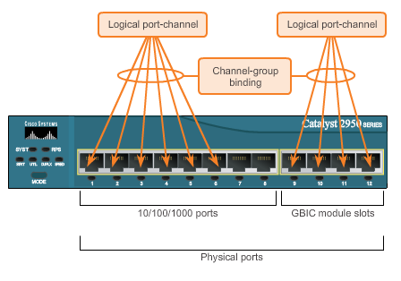
EtherChannel Operation Implementation Restrictions
EtherChannel implemented by grouping multiple physical ports into one or more logical EtherChannel links.
Interface types cannot be mixed.
EtherChannel provides full-duplex bandwidth up to 800 Mb/s (Fast EtherChannel) or 8 Gb/s (Gigabit EtherChannel).
EtherChannel can consist of up to 16 compatibly-configured Ethernet ports.
The Cisco IOS switch currently supports six EtherChannels.
Notes:
3.1.2.1 Implementation Restrictions

Slide 6
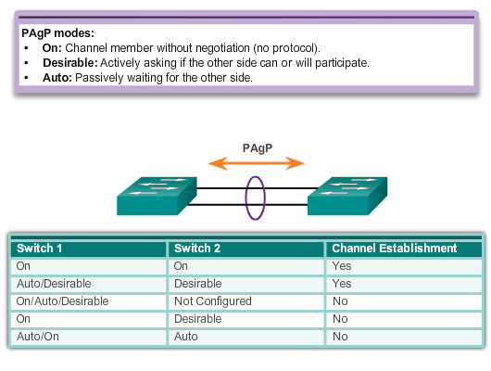
EtherChannel Operation Port Aggregation Protocol (PAgP)
Notes:
3.1.2.2 Port Aggregation Protocol
PAgP is cisco proprietary

Slide 7
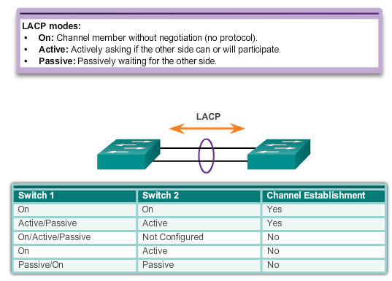
EtherChannel Operation Link Aggregation Control Protocol (LACP)
Notes:
3.1.2.3 Link Aggregation Control Protocol

Slide 8
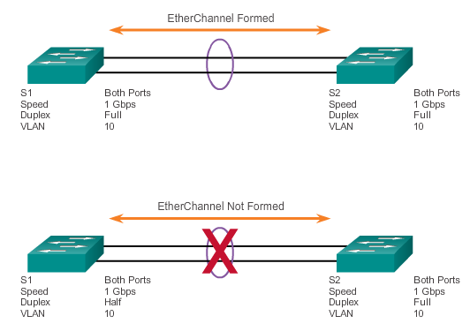
Configuring EtherChannel Configuration Guidelines
EtherChannel must be supported.
Speed and duplex must match.
VLAN match – All interfaces are in the same VLAN.
Range of VLAN – Same range on all interfaces.
Notes:
3.2.1.1 Configuration Guidelines

Slide 9
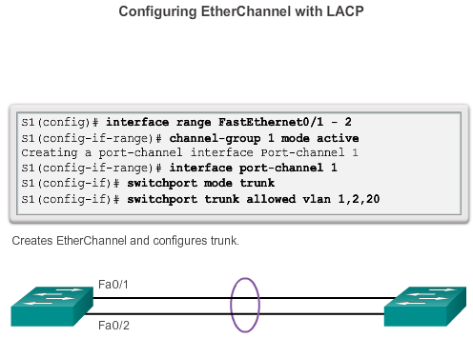
Configuring EtherChannel Configuring Interfaces
Notes:
3.2.1.2 Configuring Interfaces

Slide 10
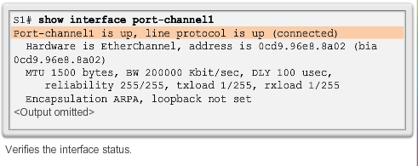
Verifying and Troubleshooting EtherChannel Verifying EtherChannel
show interface Port-channel – Displays the general status of the EtherChannel interface.
show etherchannel summary – Displays one line of information per port channel.
show etherchannel port-channel – Displays information about a specific port channel interface.
show interfaces etherchannel – Provides information about the role of the interface in the EtherChannel.
Notes:
3.2.2.1 Verifying EtherChannel

Slide 11
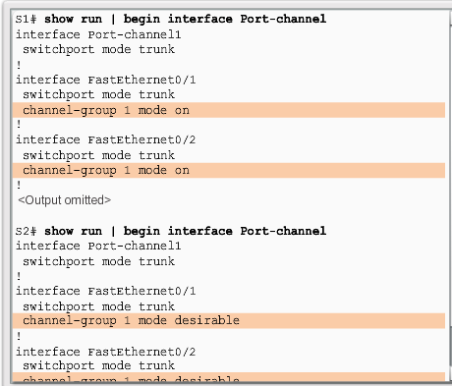
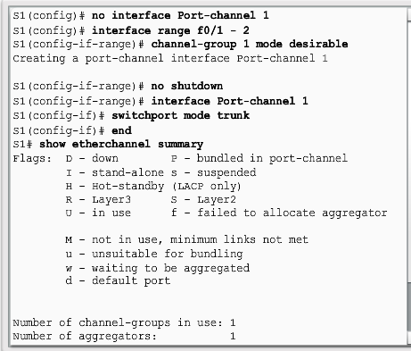
Verifying and Troubleshooting EtherChannel Troubleshooting EtherChannel
Notes:
3.2.2.2 Troubleshooting EtherChannel

Slide 12
Layer 3 Etherchannel
SW1(config)#interface range fastEthernet 0/1 - 2
SW1(config-if-range)#no switchport
SW1(config-if-range)#channel-group 12 mode on
Creating a port-channel interface Port-channel 12
SW1(config)#interface port-channel 12
SW1(config-if)#ip address 192.168.12.1 255.255.255.0
Notes:
Routed port

Slide 13
Etherchannel Load-balancing
port-channel load-balance { dst-ip | dst-mac | src-dst-ip | src-dst-mac | src-ip | src-mac }
dst-ip —Load distribution is based on the destination-host IP address.
dst-mac —Load distribution is based on the destination-host MAC address of the incoming packet.
src-dst-ip —Load distribution is based on the source-and-destination host-IP address.
src-dst-mac —Load distribution is based on the source-and-destination host-MAC address.
src-ip —Load distribution is based on the source-host IP address.
src-mac —Load distribution is based on the source-MAC address of the incoming packet (Default)

